Slide 1
DOI Section 508 Outreach Event Integrating Accessibility into Information and Communication Technology Improving Accessibility with ArcGIS Online Web Apps
Charmel Menzel
Esri GIS Solution Engineer
cmenzel@esri.com
May 16, 2019

Slide 2
Presentation Topics
What is Accessibility in online web apps?
Color and color contrast
Text alternatives
Focus and tab order
Map for non-sighted users
Do It Yourself accessibility testing
Additional Resources

Slide 3
What is Accessibility?
Make content usable for everyone regardless of abilities

Slide 4
Disability Statistics
According to World Health Organization
10% of all adult Americans have some degree of vision loss. That’s 23.7 million American adults age 18+.
20% of Americans are deaf or hard of hearing. That’s 48 million Americans.
Photo Credit: Luis Miguel Justino
Notes:
Statistics Source: https://www.3playmedia.com/accessibility-online-video-stats/

Slide 5
Wide Range of Disabilities
Disability | Permanent | Temporary | Situational
Touch | One arm | Arm injury | New parent
See | Blind | Cataract | Distracted driver
Hear | Deaf | Ear infection | Bartender
Speak | Non-verbal | Laryngitis | Heavy accent

Slide 6
Why is Accessibility Important?
The American Disabilities Act (ADA)
Section 508 – government-wide IT accessibility
Known as universal design or inclusive design
People with different abilities should have equal access to web
Good accessibility is good user experience

Slide 7
WCAG Web Content Accessibility Guidelines

Slide 8
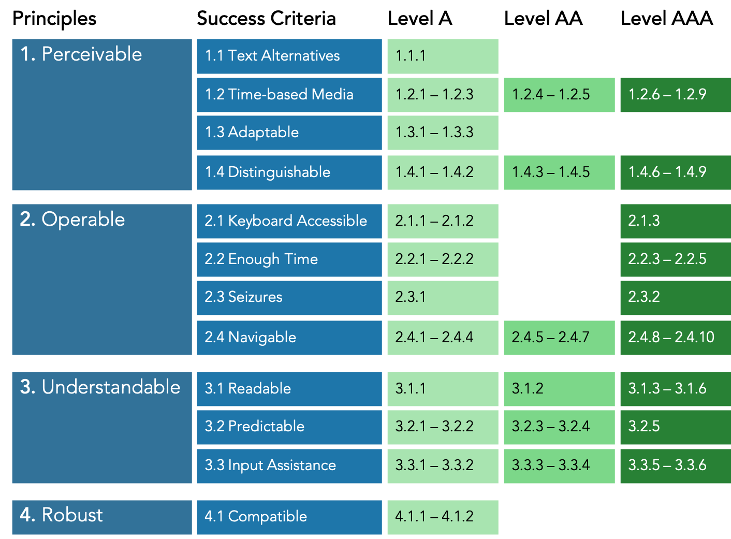
WCAG 2.0 Overview

Slide 9
What is Esri doing to improve accessibility?
Reviewing products internally for compliance
Esri reports the current accessibility status of Esri products using the Voluntary Product Accessibility Template® (VPAT®).
Industry and government personnel developed the VPAT as an informational tool to assist federal information technology professionals with the market research requirements of Section 508.

Slide 10
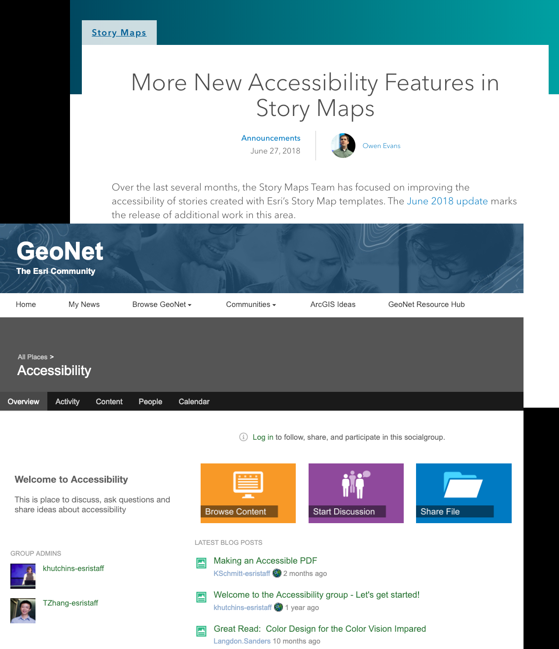
What is Esri doing to improve accessibility? (continued)
Fixing accessibility issues
Adding accessibility into new features
Sharing knowledge and best practices

Slide 11
Color and Color Contrast

Slide 12
Color Contrast
WCAG 2.0 to meet Minimum Level AA (WCAG 1.4.3)
Text and images of text need contrast ratio of at least 4.5:1
Large text and images of large-scale text need contrast ratio of at least 3:1
Incidental: Text or images of text that are part of an inactive user interface component, that are pure decoration, that are not visible to anyone, or that are part of a picture that contains significant other visual content, have no contrast requirement.
Logotypes: Text that is part of a logo or brand name has no minimum contrast requirement.
Notes:
For regular text, this is a 4.5:1 luminance ratio and for large text and graphical objects, the ratio is 3:1.

Slide 13
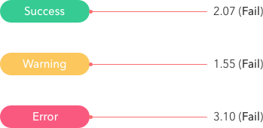
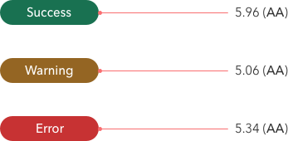
White Text on Colored Background
Light Colored Background with White Text Fails
4.5 contrast ratio
Dark Colored Background with White Text Meets
4.5 contrast ratio

Slide 14
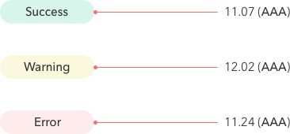
Flip the Color Contrast
Light Colored Background
With Dark Text Meets
4.5 contrast ratio

Slide 15
ArcGIS Online Map Viewer

Slide 16
What is the Map Viewer?
Create 2D maps
Contains
Base map
Set of data layers
Edit Data
Perform Analyses
Sharing Options
Copy the short URL and paste it into an email, blog, or website
Embed the map in a website
Create an app
Click the Facebook and Twitter buttons in the Share pop-up.
Example

Slide 17
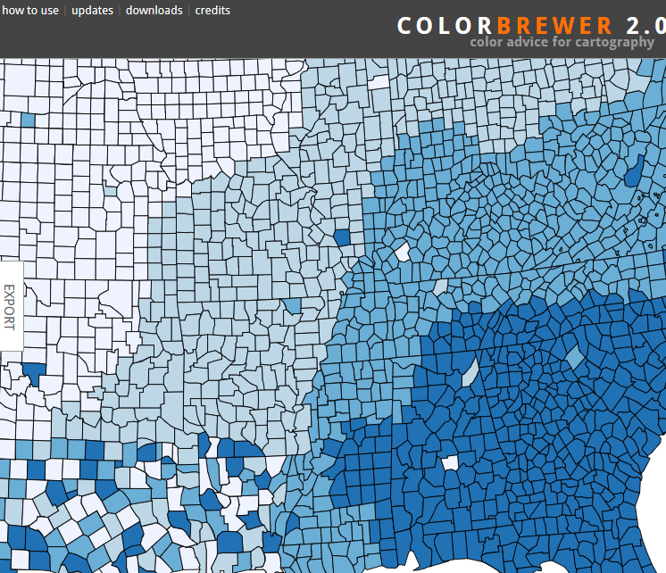
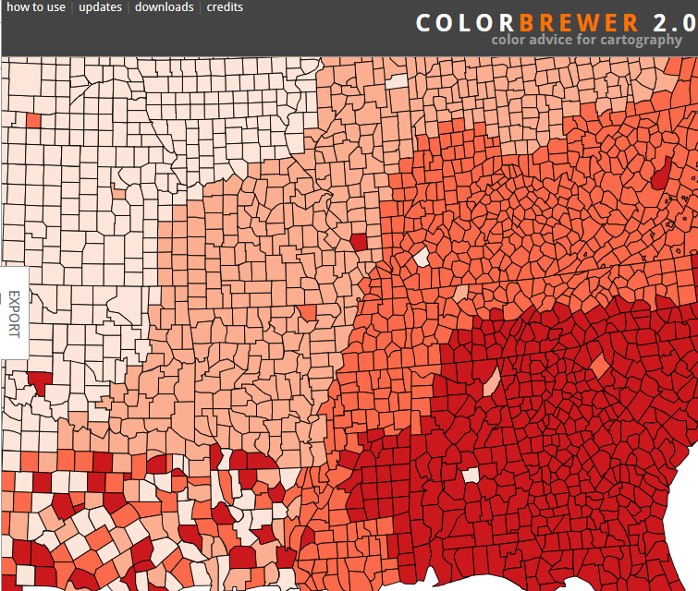
Color Theory For Maps – Same Color
Colors produce different sensory experiences
Same Data in maps below
Blue suggests water
Red suggests heat
Notes:
Color Brewer has been a go to color selection tool for cartographers for many years.
http://colorbrewer2.org/

Slide 18
Color Theory For Maps – Different Colors
Differentiating features by color alone may present challenges for visually impaired audiences

Slide 19
Use of Color Alone
Color is not the only visual means of conveying information (WCAG 1.4.1)

Slide 20
Designing Maps – Options to Consider
2
1
3
Vary
Labels and Color
Utilize
Different Shapes
Change both
Size and Color Value
of same shape

Slide 21
Test Color and Contrast
Look for content differentiated by color only
Use a contrast ratio calculator
Review color contrast issues reported by automated test tool (aXe)
Select compliant color palette (ColorCube)
Notes:
https://contrast-ratio.com/
https://chrome.google.com/webstore/detail/axe/lhdoppojpmngadmnindnejefpokejbdd
https://oomphinc.github.io/colorcube/#results-content

Slide 22
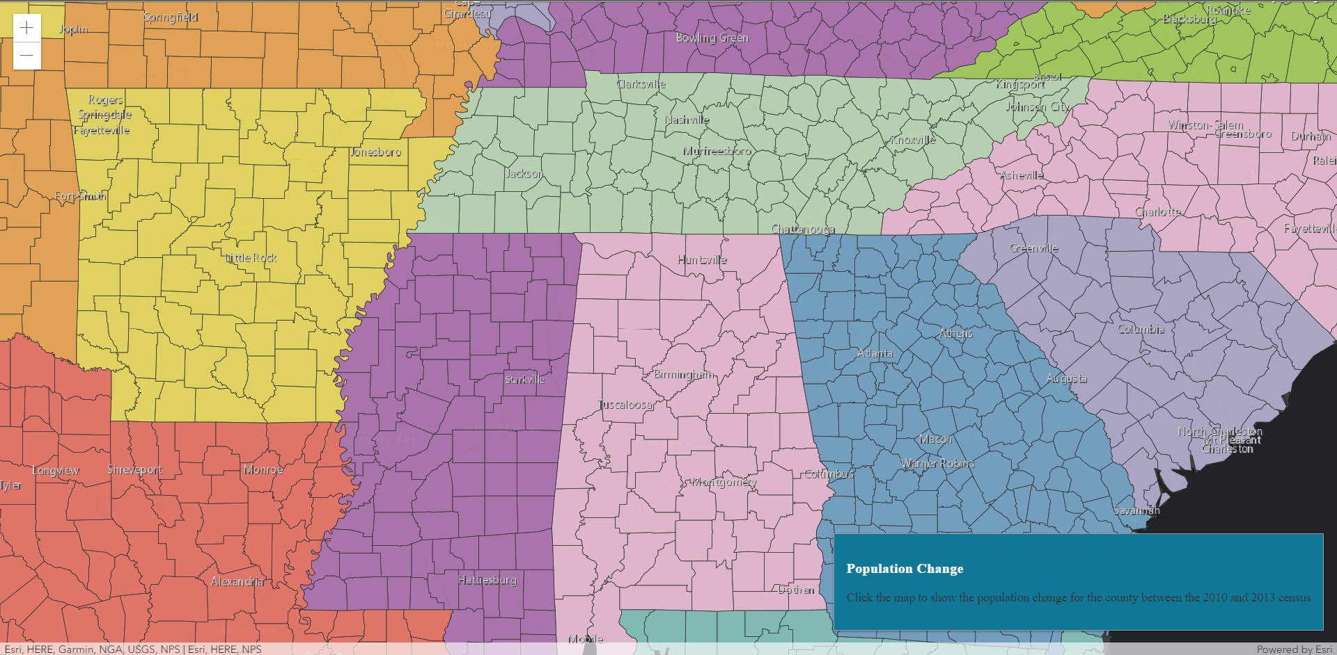
Color and Contrast Demonstration

Slide 23
Automated Test with aXe
Tests rendered page in browser
Less false positives
Accessible
Notes:
https://www.deque.com/axe/

Slide 24
Text Alternatives in ArcGIS Web Applications

Slide 25
Alternative Text (referred to as Alt Text)
Non-text content has text alternative
If image is decorative, in the code use alt equal “blank”
Reference: WCAG 1.1.1

Slide 26
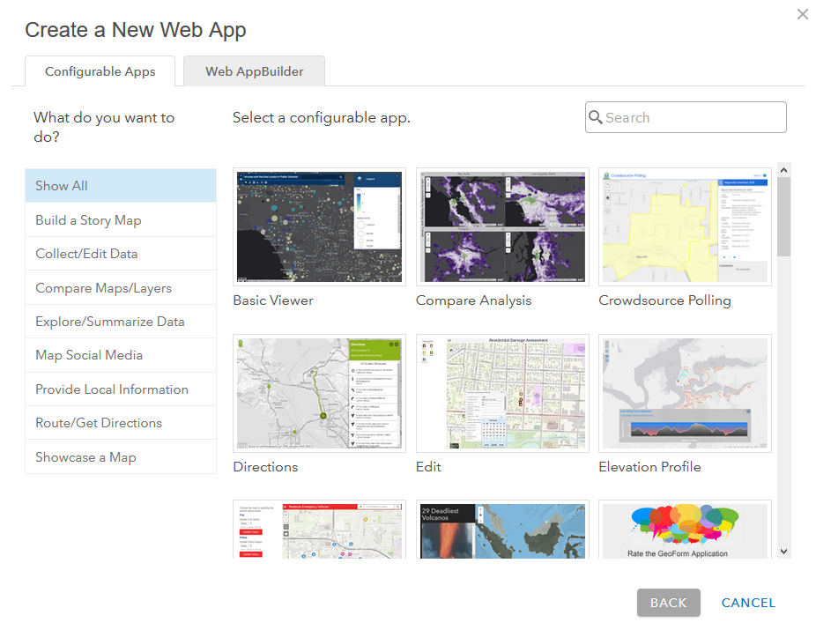
ArcGIS Web Applications
Create using
ArcGIS for Developer Tools
Configurable Application Templates
Easiest way to deploy a web app
Designed to support specific workflows
Over 25+ options

Slide 27
Map to Web App
Select
Configurable
App Template
Share
Web Map Application
From
Map Viewer

Slide 28
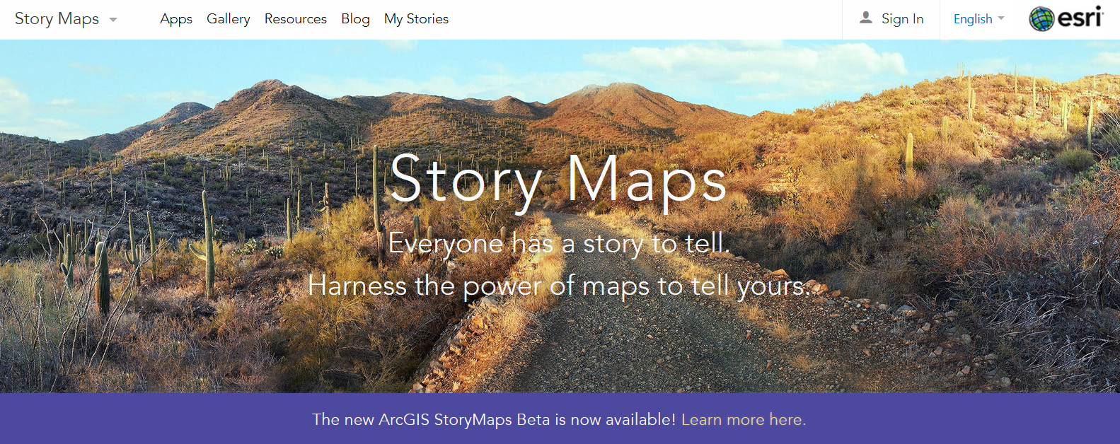
Configurable Web Application
ArcGIS Story Maps Most Popular https://storymaps.arcgis.com/en/

Slide 29
ArcGIS Story Map
Story Map Series
improved keyboard navigation
default theme for each layout meets WCAG 2.0 AA contrast guidelines
Story Map Series, Story Map Cascade and Story Map Journal
provide authors the ability to add alternative text for media elements
Story Map Series, Story Map Tour, and Story Map Shortlist
improved screen reader support
Notes:
From blogs:
https://www.esri.com/arcgis-blog/products/story-maps/constituent-engagement/more-new-accessibility-features-in-story-maps/
As of the June 2018 release, the ability to add alternative text is available in Story Map Cascade, Story Map Series and Story Map Journal.

Slide 30
Adding Alt Text to Story Maps
Notes:
when you configure content to appear in the main stage of a section of a Journal or Series story you’ll see the Alternative Text box, as shown below (click an image to expand it). The box is expandable by dragging the lower right corner if you need more space.
https://www.esri.com/arcgis-blog/products/story-maps/sharing-collaboration/improve-accessibility-of-your-story-map-journal-by-adding-alternative-text/

Slide 31
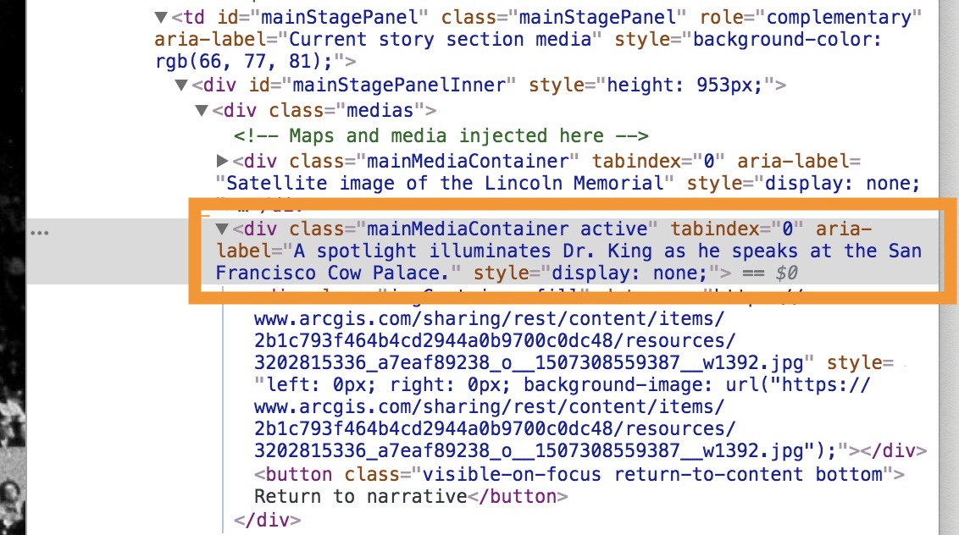
Alt Text Added to HTML using Aria-label tag
Notes:
When you add alt text to a story, it won’t be visible anywhere in the finished story so sighted readers won’t see the alt text.
To get technical for a moment, the story map template attaches the alt text you enter to the aria-label tag of the media container <div> element in the story map’s HTML code. Screen reader apps know how to find text attached to aria-label tags and speak it when the corresponding media has focus.
https://www.esri.com/arcgis-blog/products/story-maps/sharing-collaboration/improve-accessibility-of-your-story-map-journal-by-adding-alternative-text/

Slide 32
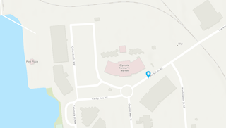
Effective Alt Text
Concise
Do Not Repeat - No need to use the phrase "image of ..." to describe images
Include text within image
For Maps, communicate purpose and function
Describe the map
Do not list features
Remember context
Provide data in an alternative format
The Esri Olympia regional office is located at 111 Market St NE Suite 250 across the street from the Farmer's Market.
Notes:
https://www.esri.com/arcgis-blog/products/story-maps/sharing-collaboration/improve-accessibility-of-your-story-map-journal-by-adding-alternative-text/

Slide 33
Focus and Tab Order in ArcGIS Web Applications

Slide 34
Focus and Tab Order
WCAG 2.4.7: Interactive elements should have clear focus.
WCAG 1.3.2: Navigation (tab) order should be logical and intuitive.
WCAG 2.1.1: Keyboard users should be able to use functionalities using keyboard only.
WCAG 2.1.2: Content does not "trap" keyboard focus within subsections.

Slide 35
Two Demonstrations: Focus and Tab Order Demo Link Focus Trap in Dialog Demo Link

Slide 36
Keyboard Navigation with Tab Reveals Hidden Buttons
Press Tab key to activate reader.
ArcGIS Story Maps first button is “Skip to Narrative”

Slide 37
ArcGIS Map Viewer Default Map Navigation
Action | 2D Map Viewer Behavior
Arrow Keys | Nudge the view to left, right, up or down
+ | Incrementally zoom in at the center of the map
- | Incrementally zoom out at the center of the map
For more information, go to Map Viewer documentation click here
Notes:
https://developers.arcgis.com/javascript/latest/api-reference/esri-views-MapView.html

Slide 38
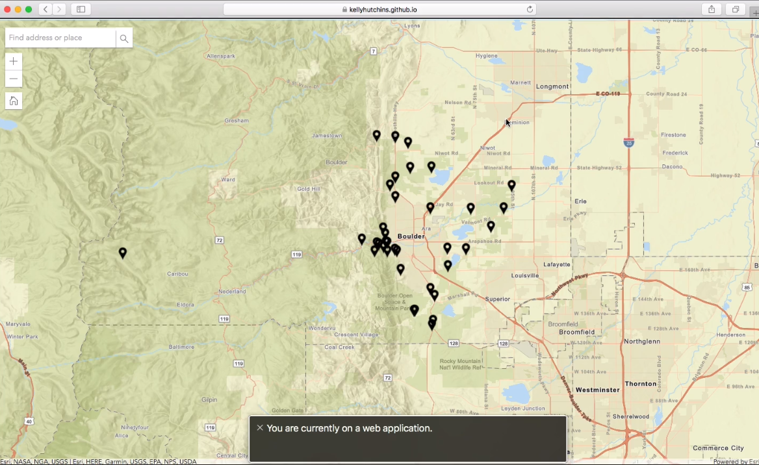
Map Web Application for non-sighted users
Video Link
Notes:
https://jimmieego.github.io/Web-Accessibility-Best-Practices/images/a11y-map-demo.mp4

Slide 39
4 Step Do It Yourself Accessibility Testing
Automated test
Keyboard test
Screen Reader test
Manual Color test

Slide 40
Additional Resources

Slide 41
Esri Accessibility Resources
Esri Community GeoNet Accessibility Group
Public Collaboration on Esri Accessibility
https://community.esri.com/groups/accessibility
Story Map Accessibility Blogs
Improve accessibility of your Story Map by adding alternative text
Accessibility features in Story Map Journal and Story Map Series

Slide 42
Esri Accessibility Resources (continued) Recent Esri Staff Accessibility Presentation Recordings
Esri DevSummit 2019
DIY Accessibility - YouTube
Accessible Web Mapping Apps: ARIA, WCAG and 508 Compliance - YouTube
Improving Accessibility with ArcGIS Online Web Apps - YouTube
Esri GeoDev Webinar January 2019
Web Accessibility Best Practices – YouTube

Slide 43
Accessibility Resources
The A11Y Project (https://a11yproject.com/) (a community-driven effort to make web accessibility easier).
Mozilla Developer Network (MDN): Accessibility https://developer.mozilla.org/en-US/docs/Web/Accessibility
Inclusive Design by Microsoft (https://www.microsoft.com/design/)
Google Developers Web Fundamentals: Accessibility (https://developers.google.com/web/fundamentals/accessibility/)
EPA Web Policies - Story Map Guidance https://www.epa.gov/web-policies-and-procedures/story-maps-guidance

Slide 44
Alternative Text Resources
WebAIM (web accessibility in mind) https://webaim.org/techniques/alttext/
4 Syllables
https://4syllables.com.au/articles/text-alternatives-images-examples/
https://4syllables.com.au/articles/text-alternatives-images-captions/

Slide 45
Color Selection Tools
Contrast Ratio (https://contrast-ratio.com/)
WebAIM.org (https://webaim.org/resources/contrastchecker/)
WCAG Luminosity Color Ratio Analyzer built by Esri Canada
Color Brewer (http://colorbrewer2.org/)
Color Oracle (https://colororacle.org/)

Slide 46
Thank You for Joining Us Today!

