Slide 1
Making Maps Accessible in PDF Documents
Rob Haverty, Sr. Product Manager Adobe, Document Cloud Accessibility

Slide 2
Agenda
Refresh on some basics of PDF accessibility
Explore different types of maps
Determine the “message” in the map
Create the appropriate Alt Text for the map
Goals:
Understand the complexity of making maps accessible in PDFs
Learn some approaches for fixing inaccessible maps in PDFs
Notes:
Abstract: Many PDF documents produced by the Department of the Interior include maps. In this session we will explore different types of maps with an eye to understanding the message behind the maps and how best to convey that message to users of assistive technologies. The goal of this session is to provide folks with guidance and techniques to use in making maps accessible in PDF documents.

Slide 3
Session 1 – Update on the Basics for PDF Accessibility

Slide 4
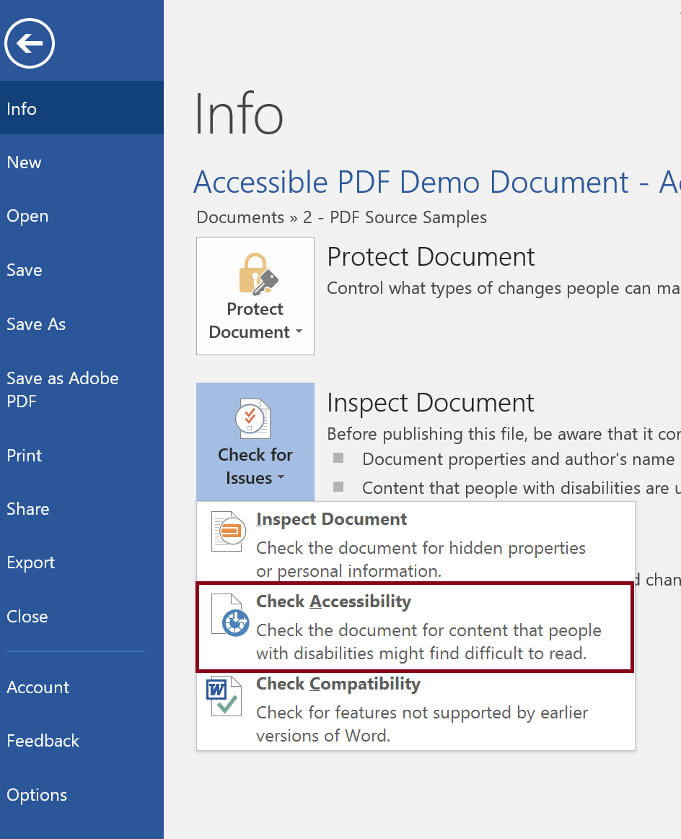
The Source Document is Supreme
It is usually easier to fix the source document then the converted PDF document.
Considerations:
  Does the authoring tool support creating an accessible document (e.g. Accessibility Checker in Word)?
  Does the author know how to create an accessible document (e.g. using Styles for Headings)

Slide 5
Selecting Content to Tag
Create “New Tag”
Select “Selection Arrow” (should be blue)
Put focus on the new tag (should be highlighted blue)
Select entire content to be included in the tag (should be shaded blue)
Put focus back on the new tag (turns from grey to blue highlight)
  Note: All three should be blue, Selection Arrow, Tag, and Content Selection
Right click on the new tag and select “Create Tag from Selection”

Slide 6
Creating Artifacts
Open the Tag Tree and find a tag to Artifact
Open Reading Order tool
Select item number for content to be artifacted
Select “Background/Artifact” in Reading Order tool
Note tag is removed from the Tag Tree

Slide 7
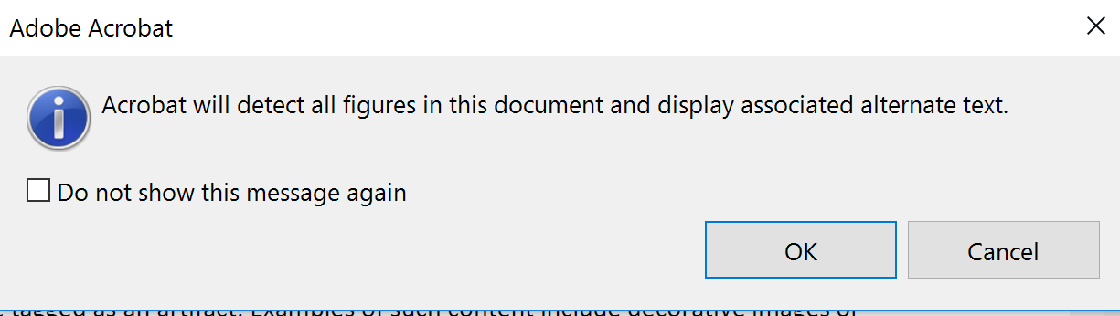
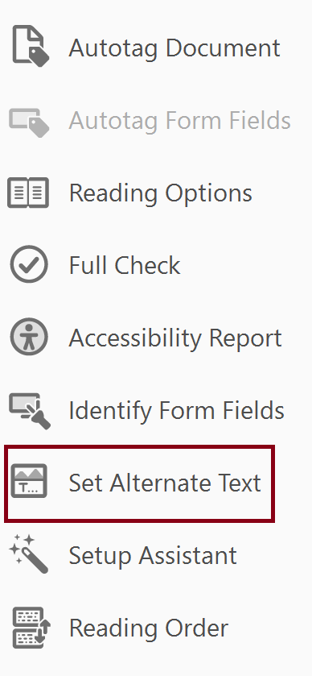
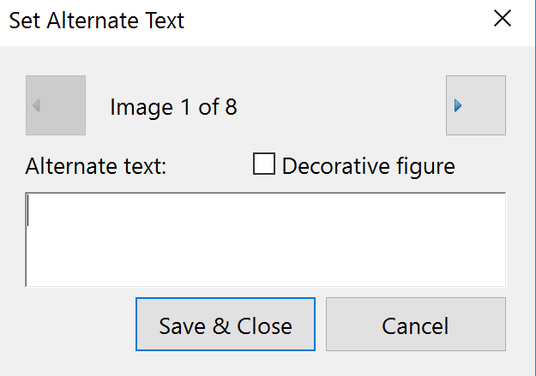
Adding Alt Text to Images
Figures with Captions (Artifact?)
Without Captions (Alternative Text)
  Accessibility Tool

Slide 9
Session 2 – Let’s Look at Some Maps

Slide 10
Demo

Slide 11
Session 3 – Making Maps Accessible

Slide 12
Demo

Slide 14
Training Options and Materials
Regular Webinars
    https://events-ar.adobeconnect.com/content/connect/c1/881497641/en/events/catalog.html?OWASP_CSRFTOKEN=1e73e0edb7545f3f9fdd08e895e134213f26efe05c1067bb15b4fc6234076238
Webinar Recordings
    http://adobe.lookbookhq.com/acrobataccessibility
Upcoming Train-the-Trainer session at Accessing Higher Ground Conference (Teaching you how to teach others how to create accessible PDFs). November 2019 in Colorado
    www.accessinghigherground.org

Slide 15
Acrobat Pro DC Helpful Links and Resources
Acrobat DC Accessibility
    https://www.adobe.com/accessibility/products/acrobat.html
Adobe Acrobat DC Accessibility Features
    https://www.adobe.com/accessibility/products/acrobat/acrobat-accessibility-features.html
Acrobat Reader DC Accessibility features
    https://helpx.adobe.com/reader/using/accessibility-features.html
Acrobat DC and Reader DC Accessibility Blogs
    https://theblog.adobe.com/document-cloud/ (search for PDF or Accessibility)
Using the Acrobat Pro DC Accessibility Checker
    https://www.adobe.com/accessibility/products/acrobat/using-acrobat-pro-accessibility-checker.html
Create and verify PDF accessibility
    https://helpx.adobe.com/acrobat/using/create-verify-pdf-accessibility.html
Acrobat Pro DC PDF Accessibility Repair Workflow
    https://www.adobe.com/accessibility/products/acrobat/acrobat-pro-dc-pdf-accessibility-repair-workflow.html

Slide 16
Contacts
Rob Haverty
  Haverty@Adobe.com
Adobe Accessibility Website
  www.Adobe.com/Accessibility
Accessibility Compliance
  https://www.adobe.com/accessibility/compliance.html
Follow us on Twitter @AdobeAccess
PDF Standards
  ISO 32000 (free)
  ISO 14289 (PDF/UA) (purchase)

